Slide 1
What the code!
A story about evolution of computer and programming

Slide 2
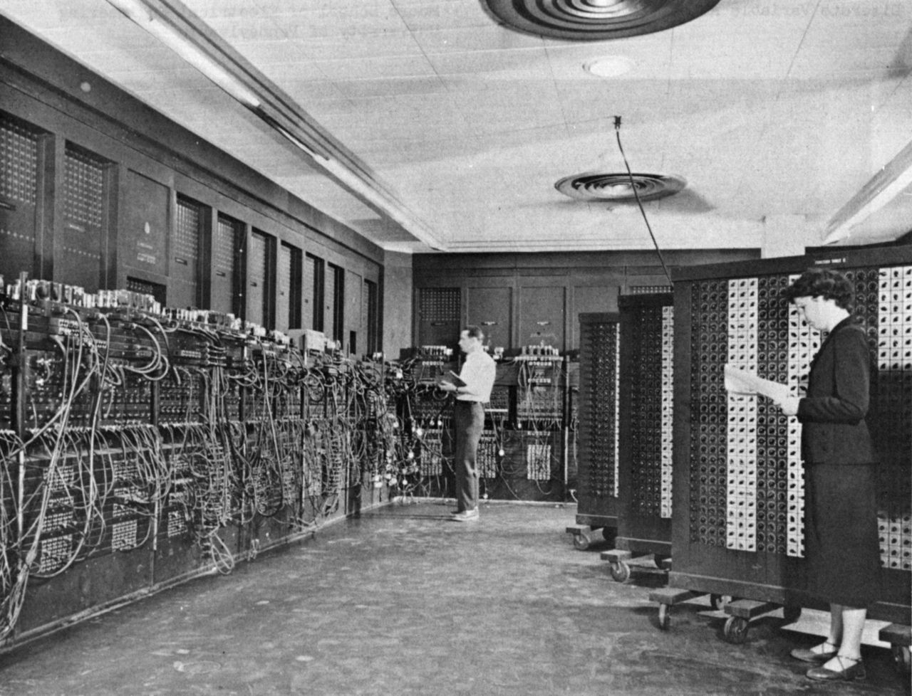
In the beginning (1946)

Slide 3
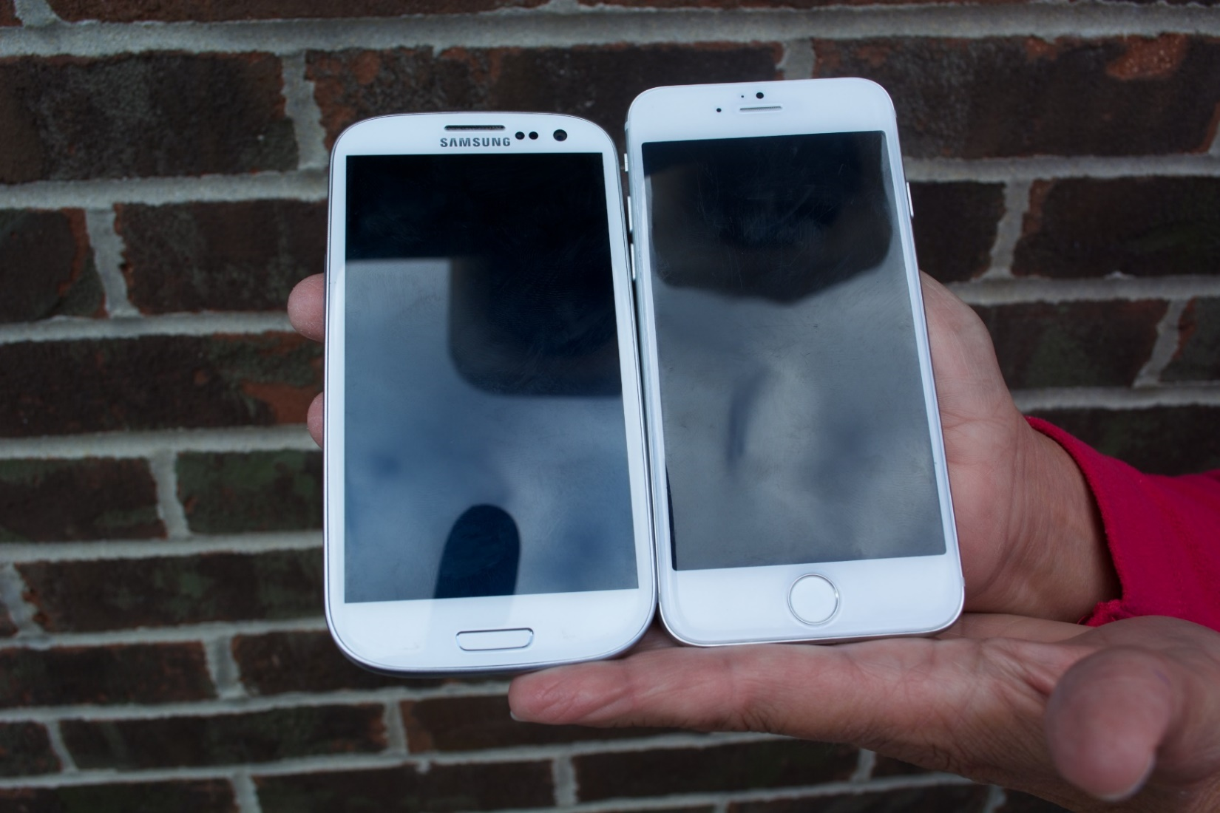
And today (2015)

Slide 4
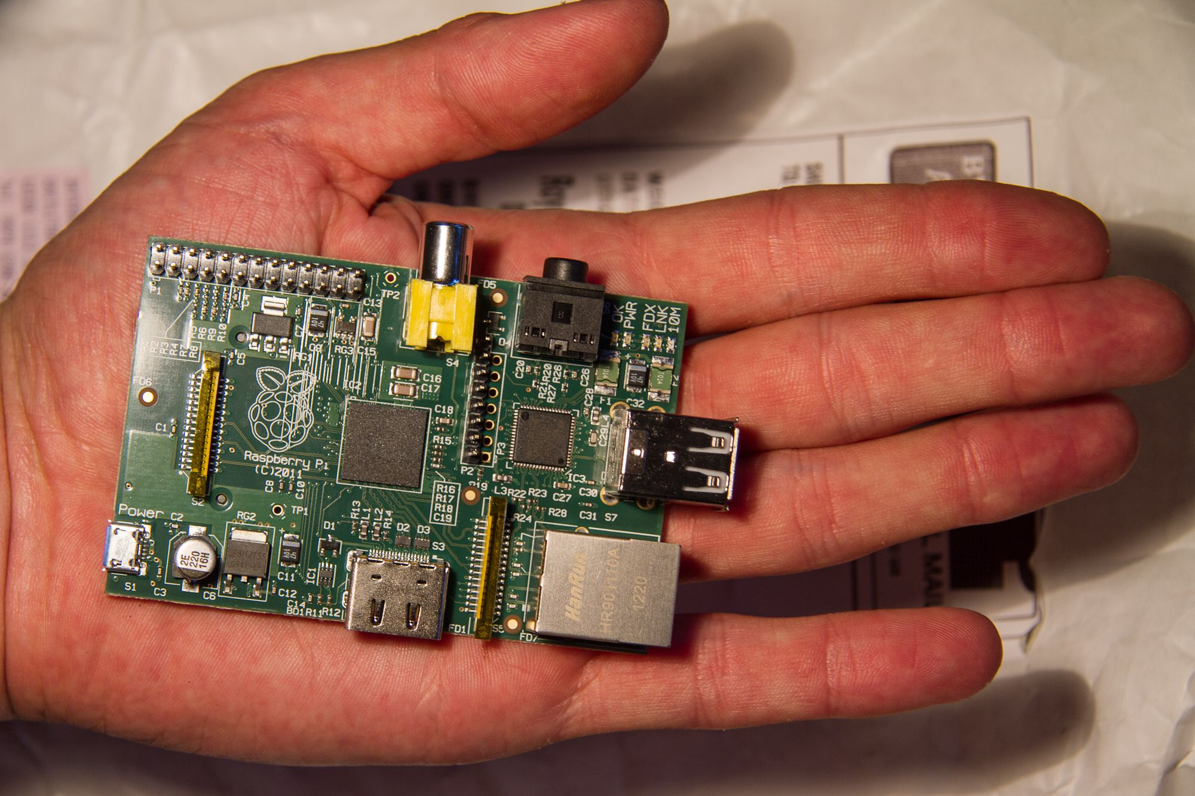
Also this (2015)

Slide 5
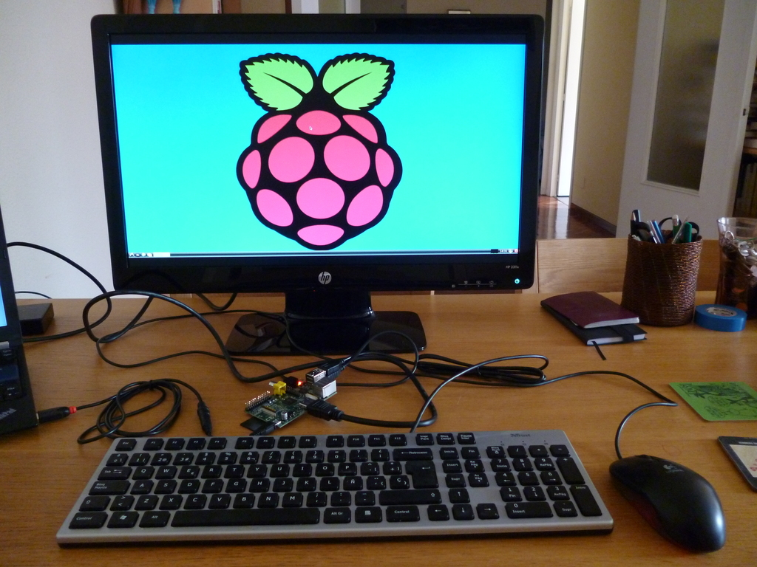
Full-Fledged

Slide 6
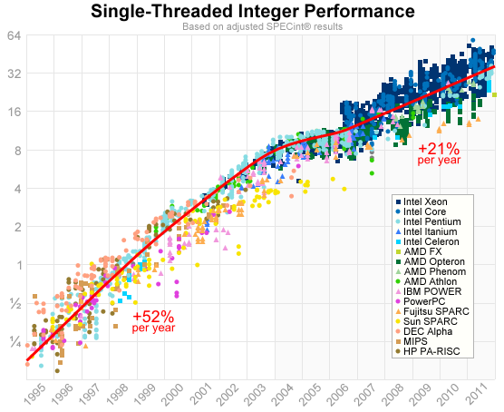
History…

Slide 7
Numbers…
PCs: 2000000000 (2 billions)
Smartphone: 3000000000 (3 billions)
Human: 7300000000 (7.3 billions)

Slide 8
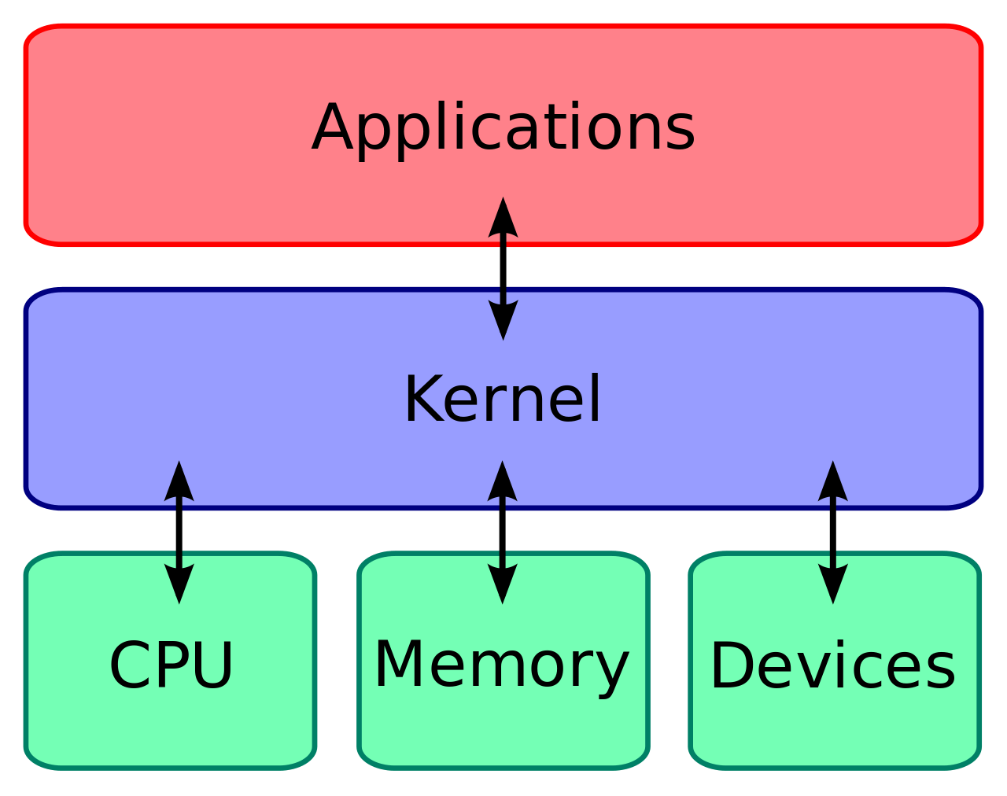
Hardware and Software

Slide 9
What behind software
puts 'Hello, world!'

Slide 10
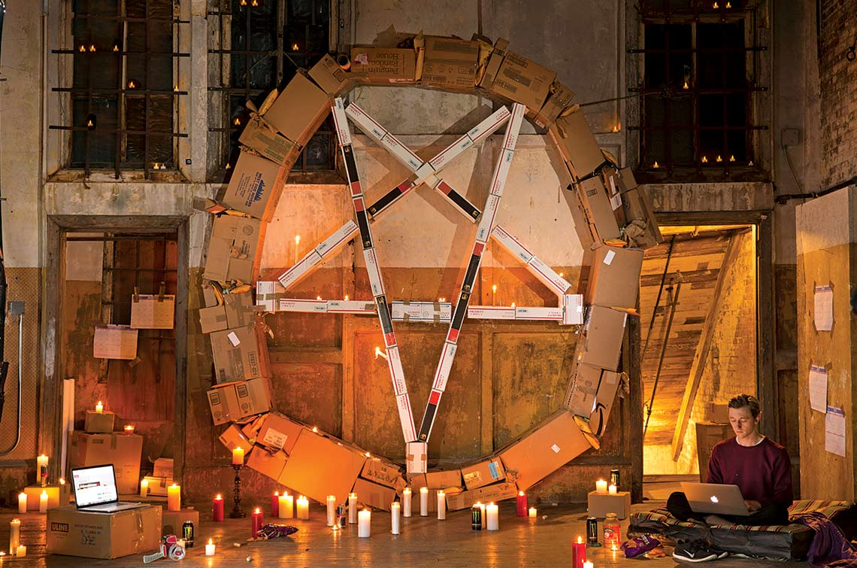
What is Code – Paul Ford
http://bit.do/whatiscode

Slide 11


Where to Start?
www.codecademy.com
www.codecademy.com

Slide 12


Where to Start?
cs101.stanford.edu
bit.do/mitocwcs

Slide 13

IRL ?

Slide 14
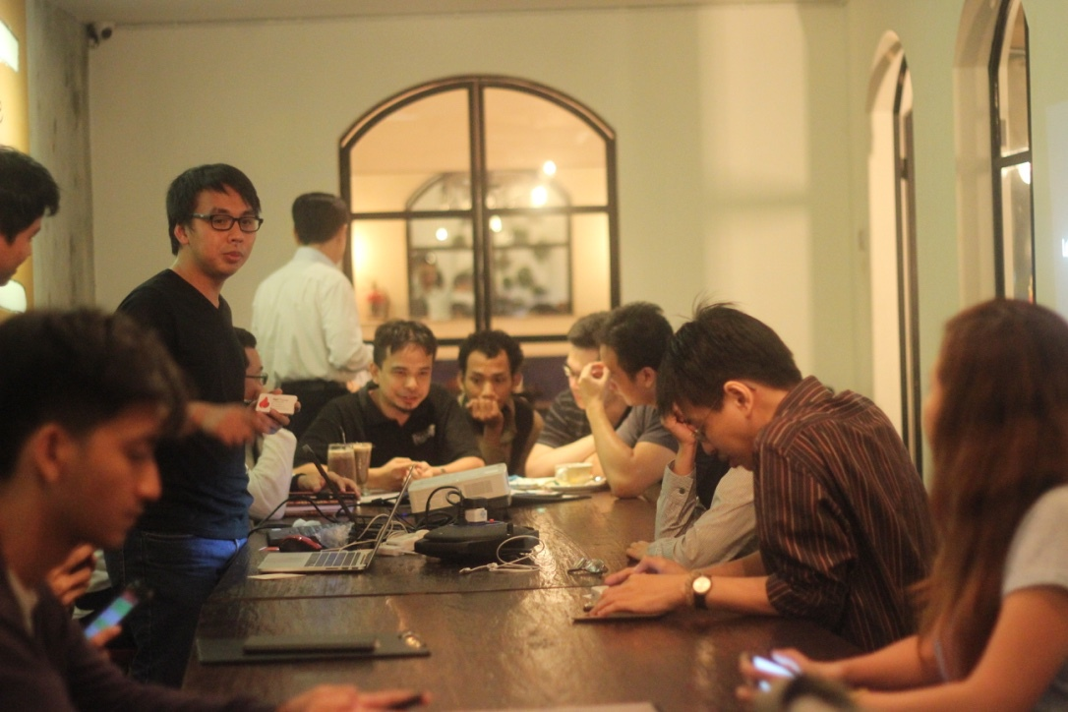
IRL ?

Slide 15
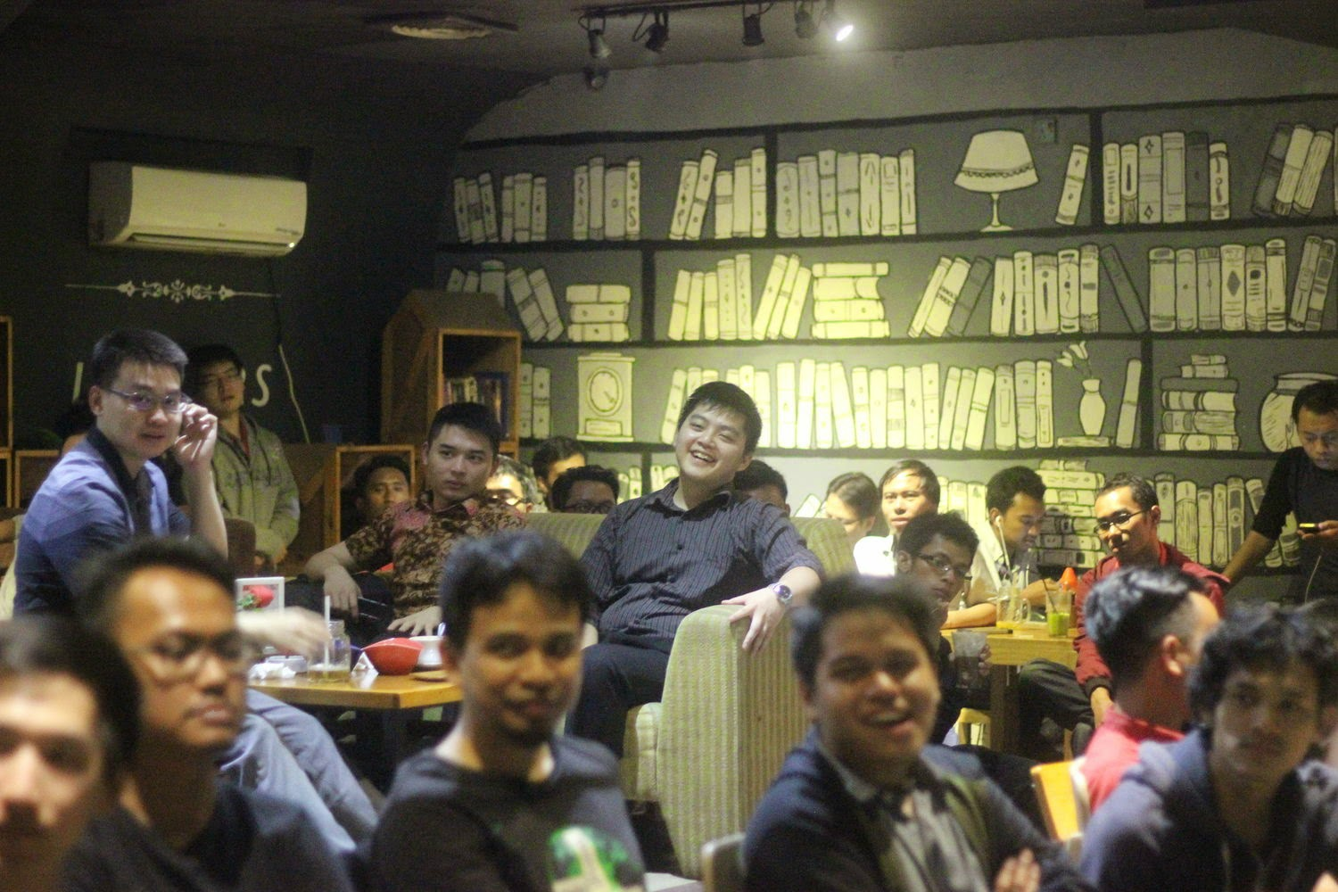
IRL ?

Slide 16
Let’s code!
Nur Agus Suryoko
Virkea Empressa Sistema / Infrastructure Architect
@berandajiwa

